Slide 1
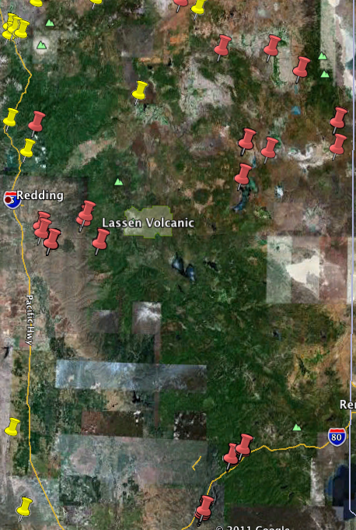
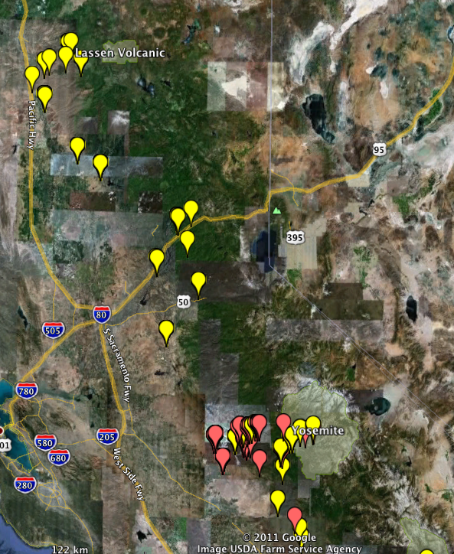

Is this real or error in MVZ DB?
Specimen records: Pre1950 are yellow, post2000 are red
N. fuscipes
N. macrotis
1998 record (Matocq)

Slide 2
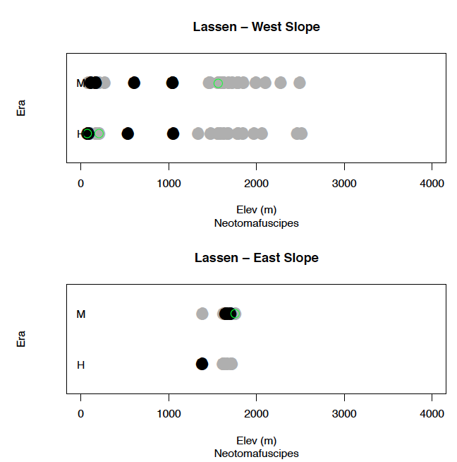
GRP DB

